Slide 1
Introduction to Programming
Control Structure - Loop

Slide 2
Control Structure
A standard sequence is interesting, but most of the time you want programs to be more reactive
Create programs with dynamic behaviour using control flow statements
Control program behaviour using the branching and looping statements
A. Cain

Slide 3
Used of Loops
One of the tasks all programs should be able to do is validate data that is input to the program.
For example, in payroll program, it should be able to validate the payrate and hours worked, and prompt for this input to be resubmitted if it is in error.
To do this we need to write a loop.
If the data is valid, the program should calculate the pay for each employee for a number of weeks.
We need a loop for this, too.
Etter/Ingber PSH/JKL

Slide 4
Repetition / Loop
while statement
do while statement
for statement
Etter/Ingber PSH/JKL

Slide 5
The Loop Variable
By definition, a loop goes around a certain number of times.
To control a loop, we need something to measure whether it is executed the correct number of times. This is the Loop Variable.
To fully control a loop, the loop variable has to be
  Initialized to a starting value for the loop
  Tested to determine when to stop looping
  Changed so that the loop test will eventually cause the loop to stop looping
Etter/Ingber PSH/JKL

Slide 6
while (also a pre-test loop)
syntax:
while (condition)
{
statement-list;
}
• if the body contains only a single statement,
then the braces may be omitted
Etter/Ingber PSH/JKL

Slide 7
while statement
single statement
while(condition)
statement;
while(condition)
{
statement;
statement;
...
}
compound (block) statement
Etter/Ingber PSH/JKL

Slide 8
while statement…
Make sure the counting variable has been declared and initialised before the while loop starts.
usage:
int i = 0;
…
while(i < 3)
{
printf(“Year %i\n", i);
…
i++;
}
put at the start of the block or at the end (best).
Etter/Ingber PSH/JKL

Slide 9
do while
do
{
statement_1;
statement_2;
...
} while(expression);
Note - the expression (while condition) is tested after the statement(s) are executed, so statements are executed
at least once.
  This is the main reason for the existence of the do…while statement.
compound (block) statement
there MUST be a semi-colon here;
Etter/Ingber PSH/JKL

Slide 10
do while
int i = 0;
…
do
{
printf(“Year %i\n", i);
…
i++;
}while (i < 3);
Etter/Ingber PSH/JKL

Slide 11
while statement..
The while statement must have an initialiser (i = 0).
The while statement must have an increment / decrement (i++, i--).
The programmer is responsible for setting the values of the variables in the while condition.
  If the condition never becomes false, the loop will continue forever (or until a crash or Control+C).
Etter/Ingber PSH/JKL

Slide 12
for statement
for(initialize; test; increment/decrement)
{
statement_1;
statement_2;
. . .
}
Etter/Ingber PSH/JKL

Slide 13
for statement.
Tested each time before executing loop body
Executed once
at the start
for( i = 0; i < 10; i++)
{
printf(".");
}
Executed each time after execution of loop body
Etter/Ingber PSH/JKL

Slide 14
for example.
int j = 0; memory: j
int n = 10; n
int i; i
for(i = 0; i < n; i++)
{
j++;
printf("counting… %i\n", j);
}
0
1
2
10
true
?
0
1
2
counting 1
counting 2
counting 3
Etter/Ingber PSH/JKL

Slide 15
for example..
int j = 0; memory: j
int n = 10; n
int i; i
for(i = 0; i < n; i++)
{
j++;
printf("counting… %i\n", j);
}
8
9
10
true
10
false
?
8
9
10
counting 1
counting 2
counting 3
counting 4
counting 5
counting 6
counting 7
counting 8
counting 9
Etter/Ingber PSH/JKL
counting 10
Press Enter to

Slide 16
Practice!
  Determine the number of times that each of the following for loops are executed.
  for (k = 3; k <= 10; k++)
  {
  statements;
  }
  for (k = 3; k < 20; k = k + 3)
  {
  statements;
  }
  for (count= -2; count<=10; count++)
  {
  statements;
  }
Etter/Ingber PSH/JKL

Slide 17
for statement - examples
int sum = 0;
int i;
for(i = 1; i < 10; i += 2)
sum = sum + i;
int fact = 1;
int n;
for(n = 5; n > 1; n--)
fact = fact * n;
Will loop how
many times?
What’s the value
of “fact” after the
loop?
Etter/Ingber PSH/JKL

Slide 18

Nested for loop: example
This following nested for loop prints the following output:
for (int rows = 0; rows < 2 ; rows++) // outer loop
{
/*inner loop*/
for (int columns = 0; columns < 3; columns++)
printf(“(%d %d) “, rows, columns);
printf(“\n”);
}
Etter/Ingber PSH/JKL

Slide 19
Practice!
  Determine the output of the following nested for loop:
  for (j = 0; j < 3; j++)
  {
  for (k = 0; k < 2; k++)
  printf(“%i“, k);
  printf(“%i“, j);
  }
Etter/Ingber PSH/JKL

Slide 20
Valid for() loops?
for ( ; ; ) { }
for ( ; 1 ; ) { }
for (int i=0; ; i+=27) { }
for (double x=0, yy=3.14159; yy < PI ;
x-=32, yy+=0.3) { }
Invalid loop ?
for ( ; 0 ; ) { }
Etter/Ingber PSH/JKL

Slide 21
break statement
break;
  terminates (exits) the loop
  execution continues with the first statement following the loop
Etter/Ingber PSH/JKL

Slide 22
continue statement
continue;
  forces next iteration of the loop, skipping any remaining statements in the loop
Etter/Ingber PSH/JKL

Slide 23
Break and continue
A continue statement in a loop immediately breaks out of the current iteration of the loop -> it goes to the next iteration
A break statement in a loop immediately breaks out of the whole loop.
These should be used sparingly, if at all, as they contravene good structured programming practise.
Etter/Ingber PSH/JKL

Slide 24
break, continue - examples
int num = 0;
int x;
/*read in 10 positive numbers*/
/*ignore negative numbers*/
/*input 0 to stop*/
for(x = 0; x < 10; x++)
{
scanf("%i", &num);
if (num == 0)
continue;
if (num < 0)
break;
printf("Number %i is %f\n", i, num);
}
Will loop how
many times?
Etter/Ingber PSH/JKL

Slide 25
Programming Practice!

Slide 26
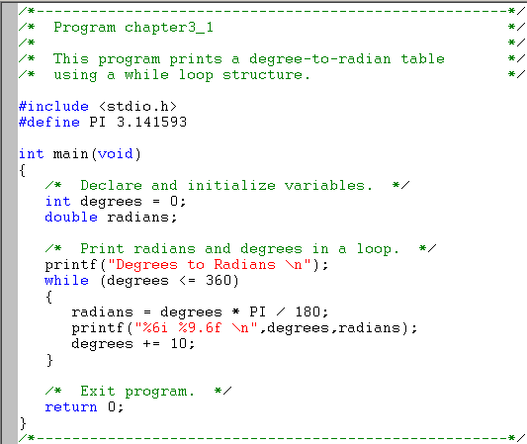
Program to Print a Table Using a while Loop (Etter page 103)
Etter/Ingber PSH/JKL

Slide 27
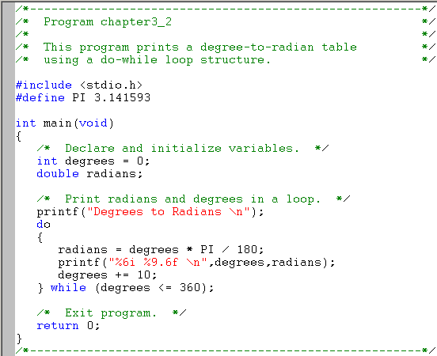
Program to Print a Table Using a do-while Loop (Etter page 104)
Etter/Ingber PSH/JKL

Slide 28
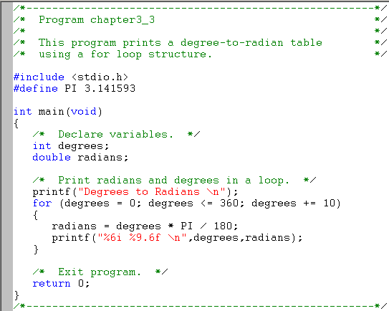
Program to Print a Table Using a for Loop (Etter page 106)
Etter/Ingber PSH/JKL

